Slide 1
Connecting Libraries to Strengthen Communities

Slide 2
Welcome and Introductions
Name and Library Name
New to the library?
New to the director position?
New to PrairieCat?

Slide 3
138 PrairieCat Members
Library Type
104 Publics
31 Schools
3 Academic/Special
Membership
83 Fully Participating
20 Basic Online
35 Union List
https://support.prairiecat.info/members
Notes:
What is PrairieCat? PrairieCat is a consortium of one hundred thirty-eight libraries in Illinois that share an integrated library system ILS. PrairieCat uses Innovative Interface's Sierra and Encore products. By sharing the costs of software and 12 support staff, libraries of all sizes and types have found it possible to join and to realize the advantages of automated resource sharing.

Slide 4
Membership Levels
Circulating Members
Fully Participating Members may use all member functionality within the PrairieCat software. Fully Participating members are voting members and may hold any office. Patrons have full access to the benefits of the ILS.
Basic Online Members may use all basic circulating, cataloging and online catalog functionality within the PrairieCat software, but not all the modules are available to Basic Online members. Basic Online members are voting members and may hold any office. Patrons have full access to the benefits of the ILS.
Union Listing Members contribute their holdings to the database for resource sharing activities only and have limited use of functionality within the PrairieCat software (Sierra). Members use staff-initiated holds to request materials for their users from other PrairieCat libraries and patrons of the library are not included as part of the patron database of the integrated library system. Union listing members have four representative who vote at Delegates Assembly.
https://support.prairiecat.info/membership-information
Notes:
There are 3 levels of membership. Fully Participating and Basic Online use the system for circulation and more.

Slide 5
Mission Statement
PrairieCat engages members in sharing resources effectively and equitably, expanding the quality and quantity of information accessible to our library users.
https://support.prairiecat.info/about

Slide 6
Resource Sharing
Notes:
Map of Resource Sharing in Northern Illinois. PrairieCat members are the blue areas. So you can see how your library has access to millions of items from across the state through PrairieCat membership.

Slide 7
1,215,185
Bibliographic Records
More than 5.1 million item records
Notes:
There are more than 1.2 million bibliographic records in the database and more than 5.1 million item records.

Slide 8
What is the difference between PrairieCat and RAILS?
PrairieCat
RAILS
PrairieCat is a consortium of 138 libraries that share an integrated library system (ILS).
The PrairieCat member libraries each have an intergovernmental agreement (legal contract) with the other PrairieCat members to share services and the ILS.
PrairieCat libraries pay PrairieCat membership fees which cover about 70% of the costs of operating the ILS.
PrairieCat receives a grant from RAILS to provide support and services to the member libraries which covers the remaining costs. RAILS uses a grant from the Illinois State Library to cover the costs in its budget for supporting PrairieCat.
RAILS membership is required to be a PrairieCat member.
The Reaching Across Illinois Library System (RAILS) is one of three state-funded regional library agencies in Illinois (the other two are Illinois Heartland Library System and the Chicago Public Library).
RAILS is primarily funded by a grant from the Illinois State Library, an office of Secretary of State and State Librarian.
RAILS has approximately 1,300 members, representing more than 4,200 individual library facilities, and has other shared consortia like PrairieCat.
RAILS not only supports resource-sharing and shared catalogs like PrairieCat, but also provides delivery, consulting, continuing education, grants and group purchasing and vendor discounts.
There are no membership fees to belong to RAILS, but all RAILS members must re-certify their membership each year.

Slide 9
What does PrairieCat do?
PrairieCat manages Sierra and Encore for member libraries. That includes:
Communicating with Innovative and other vendors
Troubleshooting problems
Assisting with cataloging
Database maintenance and cleanup
Updating circulation settings
Training members
Managing notices and alerts
Communicating and resolving issues
Managing catalog add-ons

Slide 10
What doesn’t PrairieCat do?
These are some of the library support services we get frequent questions about:
Manage delivery services (RAILS)
Provide Continuing Education Credits
Manage L2 (RAILS)
Facilitate Networking Groups
Find More Illinois (RAILS)
Explore More Illinois (RAILS)
Overdrive/Ebooks (OMNI)

Slide 11
Is it PrairieCat or RAILS???
PrairieCat support.prairiecat.info
RAILS www.railslibraries.org
Member Fees
Sierra Database
InterLibrary Loan
Training
Cataloging Services
eCommerce / Fines Paid
Statistics & Reports
No Membership Fee
Delivery Services
Continuing Education
Grants
Group Purchasing & Vendor Discounts
E-Content
Notes:
Often, members are unclear on what services PrairieCat provides and what services RAILS provides. Always reach out though and we’ll get you to the right person.

Slide 12
PrairieCat Terms
LLSAP – local library system automation program – an Illinois term for a consortium that is partially supported by an Illinois library system (e.g., RAILS).
ILS – integrated library system – also known as a library management system (LMS) – a unified computer system for a library or group of libraries, used to track items owned, orders made, bills paid and patrons who have borrowed. An ILS usually comprises a relational database, software to interact with that database, and two graphical users interfaces – one for patrons, one for staff. Separate software functions within the ILS can be called modules.
Innovative – the vendor that supplies the software for PrairieCat’s integrated library system, based in Emeryville, CA.
Sierra – the name of the staff software that PrairieCat uses.
Encore – the name of the public catalog software that PrairieCat uses.

Slide 13
PrairieCat Terms
Syndetics Unbound– reader’s advisory information available in Encore that provides series information, similar authors and titles, reviews and more.
TNS – stands for Telephone Notification System. PrairieCat uses TNS to make automated calls to patrons for holds pickup and overdues.
TRS – stands for Telephone Renewal System. Patrons can call in to renew materials via TRS at 888-542-7259.
eCommerce – the ability for patrons to pay fines and fees via My Account in Encore. Member libraries are reimbursed quarterly for eCommerce payments.
Zoom – the web meeting software tool that PrairieCat uses for remote access to meetings and training classes. Information on connecting to Zoom events are found in the L2 listing for the event.
PrairieCat Email – each library location has a PrairieCat email account in Microsoft 365 that PrairieCat uses to distribute paging lists, member notices and reports.

Slide 14
Questions??

Slide 15
Organization History
The PrairieCat consortium was legally formed in 2006.
PrairieCat went live in April 2007 on a SirsiDynix integrated library system.
The PrairieCat consortium became an Illinois Intergovernmental Instrumentality in December 2010, a separate legal entity from the library system, to protect assets and ensure sustainability.
PrairieCat signed a five year contract with Innovative Interfaces in March 2012 for a new integrated library system. The PrairieCat membership went live on the Innovative Sierra and Encore products on July 5, 2012.
In 2017, PrairieCat signed a five year contract extension with Innovative through June 2022.
In July 2018, PrairieCat staff became employed directly by PrairieCat rather than RAILS. Staffing independence was another step toward sustainability.

Slide 16
PrairieCat Organization
Delegates Assembly
Director
Systems Manager
Training and Outreach Coordinator
Library Services Manager
Admin and HR Assistant
Library Services and Database Coordinators
Cataloging and Database Coordinator
Senior Data Specialist
Systems Coordinators
Senior Systems Specialist
Administrative Council
Notes:
Prairiecat is an Illinois Intergovernmental Instrumentality – all of the PrairieCat member IGAs make up PrairieCat. So we are considered a Public Body.

Slide 17
Governance
Administrative Council
Delegates Assembly
11 Elected Members
Monthly Meetings
101 Representatives from Circulating Libraries
4 Union List Representatives
Quarterly Meetings
https://support.prairiecat.info/governance
Notes:
PrairieCat is a separate legal entity governed by two bodies. An elected 11 member board called the Administrative Council, and the Delegates Assembly, which includes a representative from each Circulating member library and the 4 Union List Representatives. Each library pays a fee to be a part of PrairieCat. Annual membership fees cover approximately 70% of the operating costs, with the remaining income coming from grant support from RAILS. PrairieCat membership is separate from RAILS membership.

Slide 18
Delegates Assembly
What is a Delegate?
Each Fully Participating and Basic Online member library appoints its chief administrator or another staff member to act as the Delegate on the Delegates Assembly. The Delegate may also designate, in writing, an alternate to vote in their absence. The four Union List member representatives are also voting members of the Delegates Assembly.
When does Delegates Assembly meet?
Delegates Assembly meets quarterly in July, October, January, and April on the last Wednesday of the month. The PrairieCat fiscal year budget is passed at the April meeting. Registration details are listed in L2 and on PrairieCat website.
Do delegates need to attend every Delegates Assembly meeting? Delegates Assembly attendance is a membership requirement for Fully Participating members, Basic Online members, and the four Union List representatives per the IGA and Bylaws. If a Delegate or Alternate for a member does not attend at least two meetings in one year, and at least once in person, that member will be charged $150.00 per PrairieCat bylaws. This rule is in place to assure that membership attends and we have sufficient quorum to carry out business.
Notes:
If you need to update or designate an alternate let us know. As a public body, PrairieCat is subject to the Open Meetings Act so we have to have an in-person quorum to conduct business.

Slide 19
Delegates Assembly
Delegates Assembly
The next Delegates Assembly is on Wednesday, October 18, 2023 10:30am to 12:30pm.
Attendance is required for Fully Participating and Basic Online members.
See PrairieCat website for details: https://support.prairiecat.info/events/prairiecat-delegates-assembly-meeting-2023-10-18
Note: This meeting was moved up a week because of ILA Conference.

Slide 20
PrairieCat Committees
Administrative Council Committees (members appointed by AC)
Elected Standing Groups (members elected by Delegates Assembly)
Finance Committee
Resource Sharing Committee
Circulation Committee
Technical Services Committee
Advisory Standing Groups (membership open)
Engagement Committee
User Experience Committee
Training Committee
https://support.prairiecat.info/events
Notes:
You can find all of the agendas and minutes for these committees on the PrairieCat support site on the event page for the meeting. If you’re interested in learning more or serving on a committee let me know.

Slide 21
Budget and Finance
Elements of PrairieCat member fees (circulating libraries):
Per library fee-flat fee. Basic Online members pay approximately 70% of the Fully Participating member amount.
“Usage” fee, made up of three-year averages of circulation, patron, and item counts
Annual Capital Reserves contribution. Basic Online members pay approximately 70% of the Fully Participating contribution
Annual hosting fee, again with Basic Online paying 70% of the Fully Participating amount
Union Listing Fees:
A per library fee that is approximately 25% of the fully participating library fee
A Capital Reserves fee that is approximately 25% of the fully participating library fee
https://support.prairiecat.info/budget-finance
Notes:
You can find the budget, membership fees, and other financials on the website.

Slide 22
Special Projects
Vega Discover | New Catalog
Visit the website for project details
Find your library’s customized catalog url on the Quick Library Lookup
PrairieCat Support Site
New site launched in June
Users log in with L2 account | Important for new staff to access training resources
PUG Day 2023
Friday, September 29, 2023 at Waubonsee Community College, Sugar Grove
PrairieCat Users Group for library staff

Slide 23
Questions??

Slide 24
Directors Spotlight
RAILS CE Archive – Directors Essentials Webinar Series for New Library Directors
RAILS CE Archive – Compliance with the Open Meetings Act
FOIA and OMA Training
Library Service Map
Annual Library Certification
Public Libraries | IPLAR Information
School Libraries | School District Library Grant Program | Deadline Oct 15
IL State Library Grant Programs

Slide 25
Logins
L2 login – Create your own Used to log in to PrairieCat Website
Talent LMS login – Create your own Different from L2/PrairieCat website
Sierra login – A mix of shared and individual or “named” logins
Communications
PrairieCat Mailing Lists https://support.prairiecat.info/mailing-lists
PrairieCat Newsletter http://eepurl.com/bW-ILD
Facebook @PrairieCatLibraries
Notes:
Now, I wanted to briefly touch on some resources and ways to stay connected with PrairieCat. To access member specific information on the PrairieCat website, you’ll need to log in with your L2 login. L2 is a statewide library calendar and directory managed by RAILS. You can visit the site to create a login if you don’t have one. Talent LMS, PrairieCat’s online training platform has a separate login. I’ve also linked here to the PrairieCat monthly newsletter and mailing lists you can subscribe to. Important director information is sent to the Delegates mailing list.

Slide 26
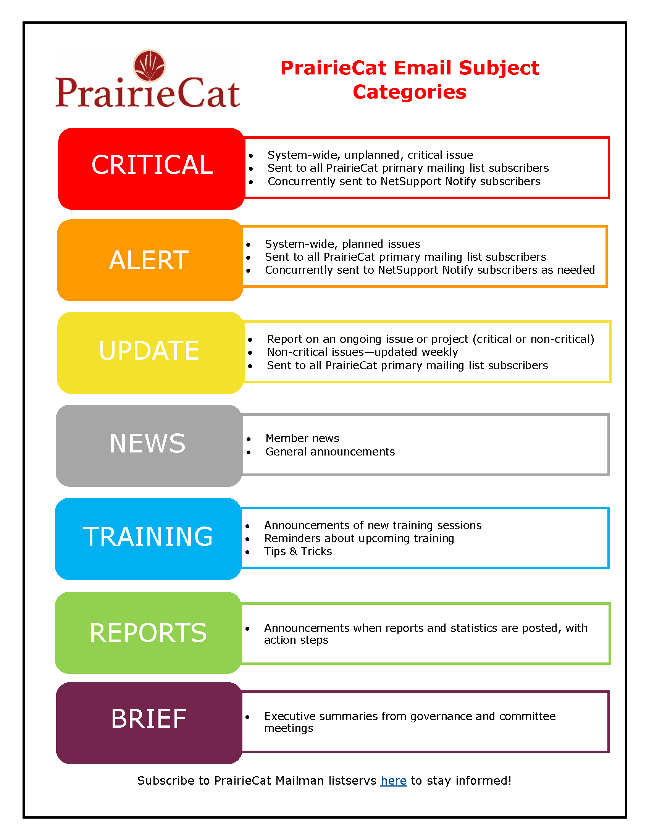
Communications
PrairieCat Mailing Lists https://support.prairiecat.info/mailing-lists
NetSupport Notify
Desktop Notification System

Slide 27
Important Websites
PrairieCat Specific
PrairieCat Website
http://support.prairiecat.info
PrairieCat Help Desk
http://helpdesk.prairiecat.info
Encore Public Catalog
http://search.prairiecat.info
PrairieCat Email (notices and paging lists)
https://login.microsoftonline.com/
Talent LMS Training
https://prairiecat.talentlms.com/
Other
RAILS
http://www.railslibraries.org
RAILS Delivery Help Desk
https://railslibraries.org/delivery
Upcoming RAILS CE events
https://railslibraries.org/education
Library Learning (L2)
https://librarylearning.org/
Illinois State Library
https://www.ilsos.gov/departments/library/

Slide 28
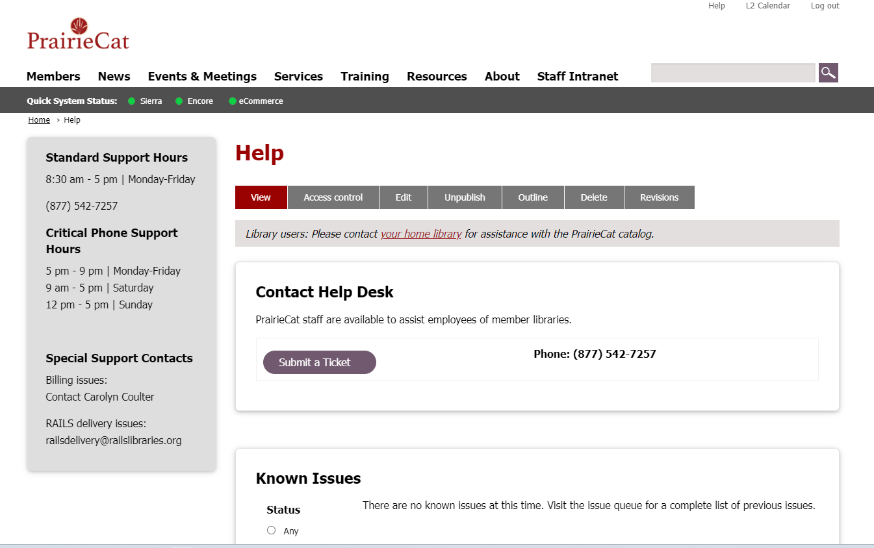
Need Help? Ask the Help Desk

Slide 29
CIRCULATION SERVICES
Please open a Help Desk ticket if you need changes made to the circulation configuration in Sierra for your library. Examples of changes PrairieCat staff make regularly are:
Loan rules and fine rate changes.
Adjusting limits by format.
Customizing date due slips, receipts or hold pickup wrappers.
Adding self-checkout workstations.
Adding days closed for holidays or special closings.
Special projects such as remodeling or moving to a new building.
Loan Rule Review – Not sure how your library’s loan rules are setup? Put in a help desk ticket.

Slide 30
SYSTEM SERVICES
PrairieCat staff produce basic monthly statistical reports and post them on the support website under Resources > Statistics and Reports. Other reports include: eCommerce transactions, items that have been too long in a certain status, new item conversions, withdrawn items, problem holds, and more.
Members can also run their own reports using Decision Center or Create List (FP only).
PrairieCat staff are also happy to run custom reports when requested, or to do bulk updates on a group of records such as a group of item or patron records. Please submit a Help Desk ticket if you have a report need or assistance with updating records.
If you are having any issues connecting to PrairieCat services, please contact us at helpdesk.prairiecat.info or 877-542-7257.

Slide 31
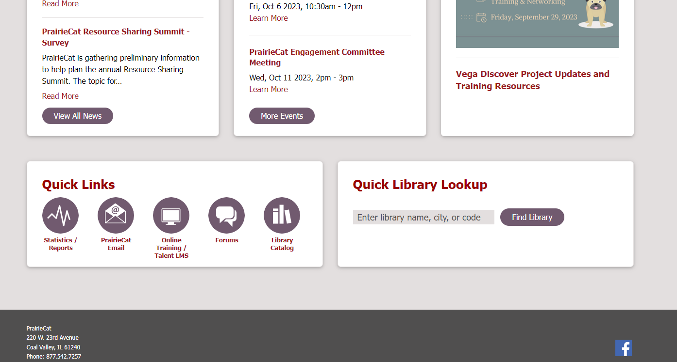
Statistics and Reports
https://support.prairiecat.info/statistics-reports

Slide 32
Cataloging
SERVICES & ITEM ENTRY CERTIFICATION
Notes:
All PrairieCat members need at least one person to be able to enter items. All the training courses are online through Talent LMS. Additional help is available on demand as an Item Entry Workshop. The training helps prepare members to complete item entry duties at their library.

Slide 33
ITEM ENTRY TRAINING PROCESS
Talent LMS Courses
Temporary Tech Login
Talent LMS Practicum
Certification
After completing practicum, your named tech login is made permanent
Complete prerequisites and series of 6 Item Entry Courses
Receive temp login to practice adding items
Complete final course by submitting examples of item records you created

Slide 34
Item Entry Courses
PrairieCat Matching: How to match items in-hand to bibliographic or title records in OCLC interfaces and the Sierra database. (Video 38:07 min.) Prerequisites: Sierra Navigation, PrairieCat Glossary, How to Search Sierra Parts 1-4
Sierra Cataloging: Item Entry – Basics: The basics of the cataloging function in Sierra and the different types of records encountered in item entry work. (Video 8:25 min.)
Sierra Cataloging: Item Entry - Anatomy of Item Record: The anatomy of an item record with explanations of each field. (Video 17:03 min.)
Sierra Cataloging: Item Entry - Call Number Standardization: The background of the standardization of the item record’s call number. (Video 5:37 min.)
Sierra Cataloging: Item Entry - Volume Records: What a volume record is and how and when to create and use a volume record, based on PrairieCat’s policy and procedure manuals. (Video 10:45 min.)
Sierra Cataloging: Item Entry - Item Record: How to add item records within the Sierra database and to briefly demonstrate the use of item record templates. (Video 20:37 min.)
Sierra Cataloging: Item Entry – Practicum: Library staff will submit scans of materials and record information for 5 item records staff enter in Sierra at their libraries. After the 3-month review period, staff will submit another 5 item records.
Notes:
Refer to Training Pathways – Item Entry Certification

Slide 35
CATALOGING SERVICES
PrairieCat staff load new bibliographic records from OCLC within 48 hours of member request, unless the file is submitted on the day before a holiday or submitted over the weekend. See PrairieCat Policies and Procedures for procedures for submitting requests.
Each PrairieCat member is entitled to original cataloging completed by PrairieCat Catalogers as part of PrairieCat membership benefits, this adds unique resources to the database where a record doesn’t currently exist in PrairieCat or OCLC. See PrairieCat Policies and Procedures to find more information on how to submit items for original cataloging.
The PrairieCat Cataloging Services team and certified member catalogers regularly perform database cleanup including record merges and clean-up, adding content to bibliographic records, multi-volume clean-up and more. Visit Resources > Forms section of the support website to find the forms to report duplicate records or needed bibliographic record clean-up. Please report issues you see, so we can keep our database as clean as possible!

Slide 36
Training
PrairieCat staff offer live, on-demand training for PrairieCat members.
The core Sierra training classes are offered online via Talent LMS. Other more technical classes are offered on-demand via Zoom (and in-person when possible). On-demand training form
The Sierra Navigation class is a prerequisite for all other Sierra classes.
PrairieCat training events that are open for all members are listed in L2 and on the PrairieCat website.
Training Resources and Documentation are posted on the PrairieCat support site. Log-in to access.
https://support.prairiecat.info/overview

Slide 37
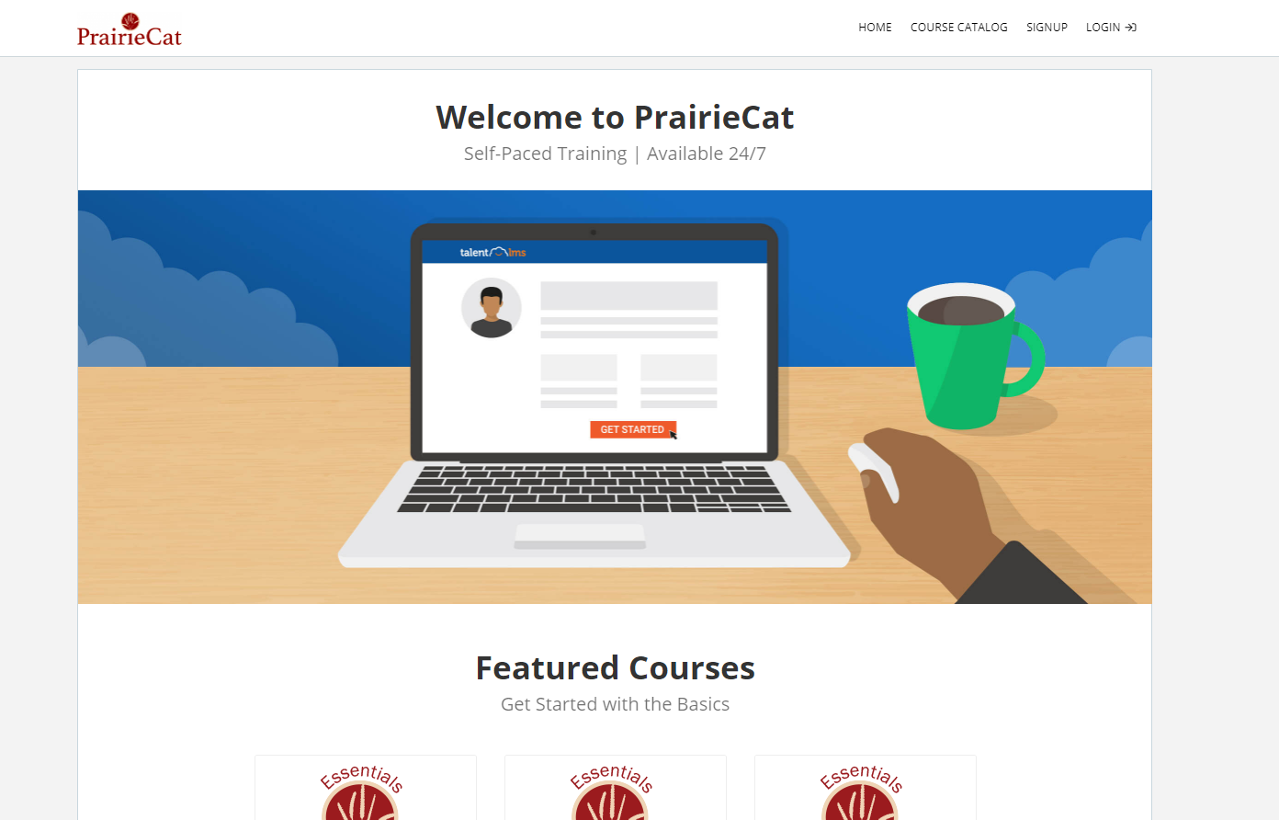
Training on Talent LMS
Self-paced
Available 24/7
Free Training
Instructor Help

Slide 38
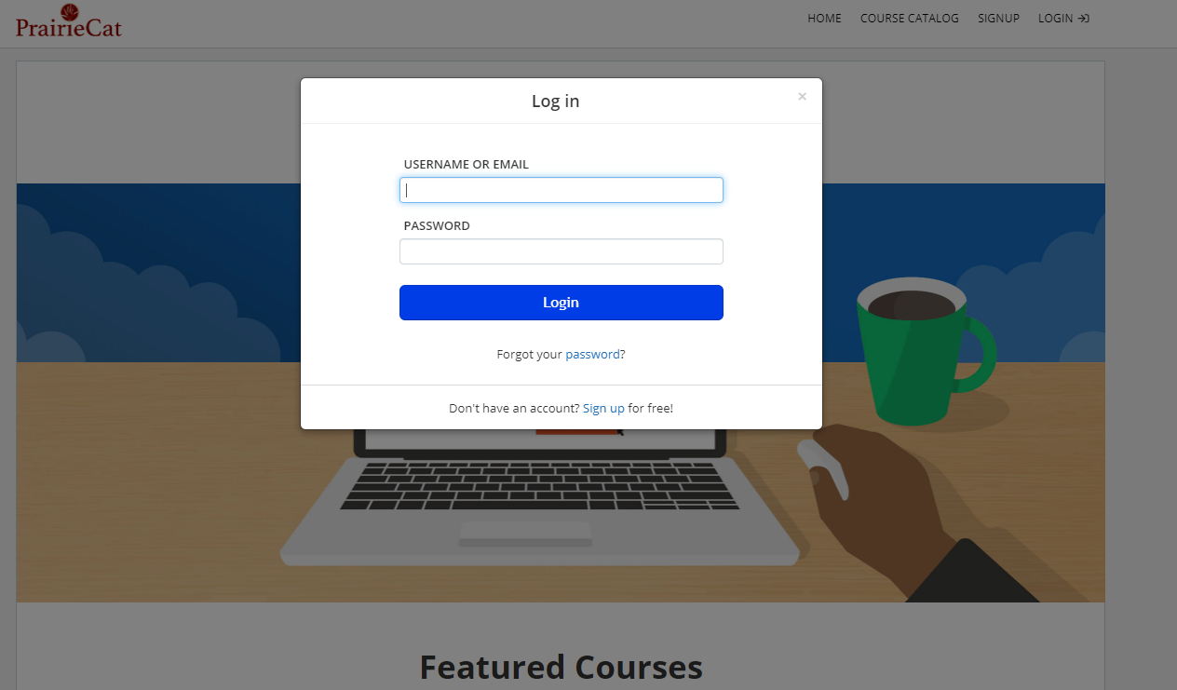
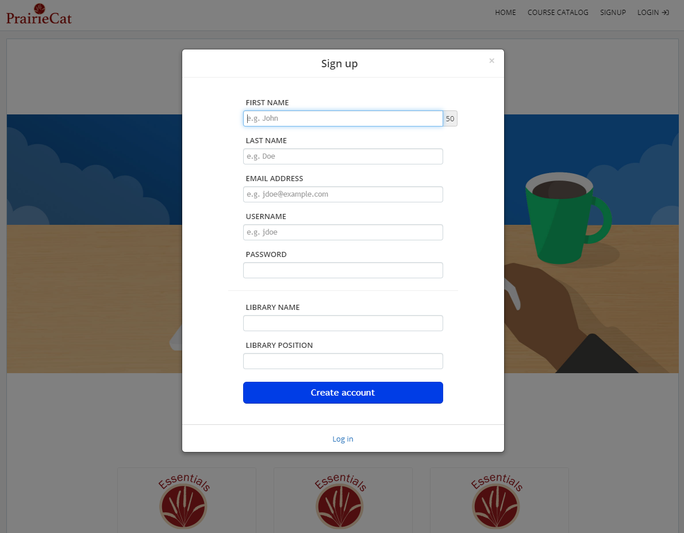
Talent LMS | Create an Account
Visit https://prairiecat.talentlms.com/
Select Signup
Enter information
Select Create Account
Notes:
Emphasize email verification within 24 hours – create L2 account so new staff can access resources and policies

Slide 39
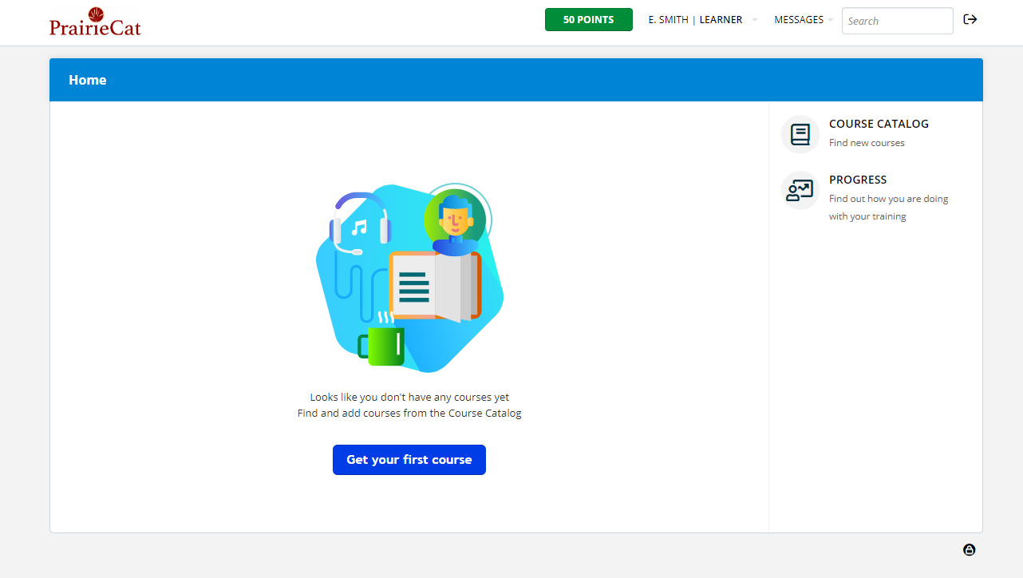
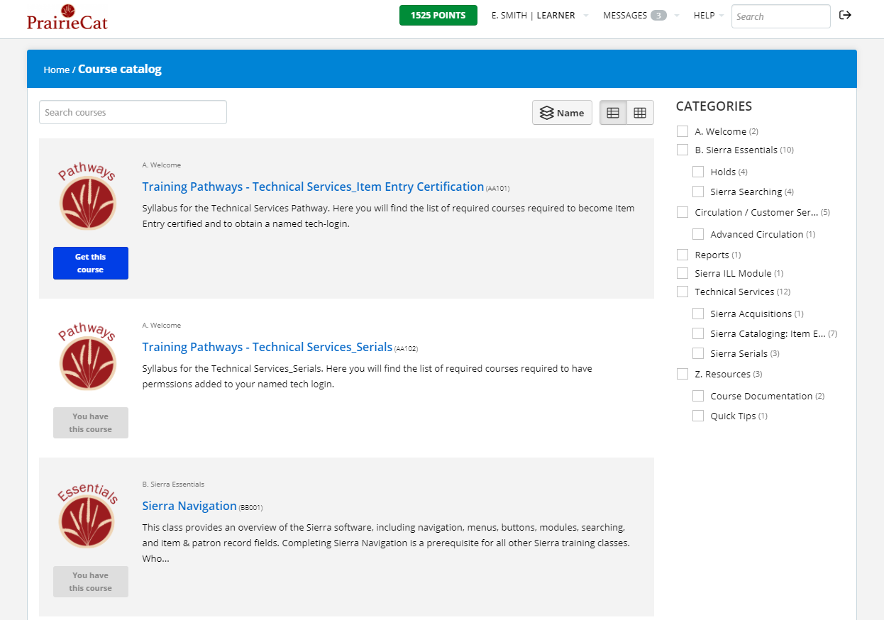
Talent LMS | Course Catalog
Select Get your first course
View Course Catalog to browse
Select Categories to limit results

Slide 40
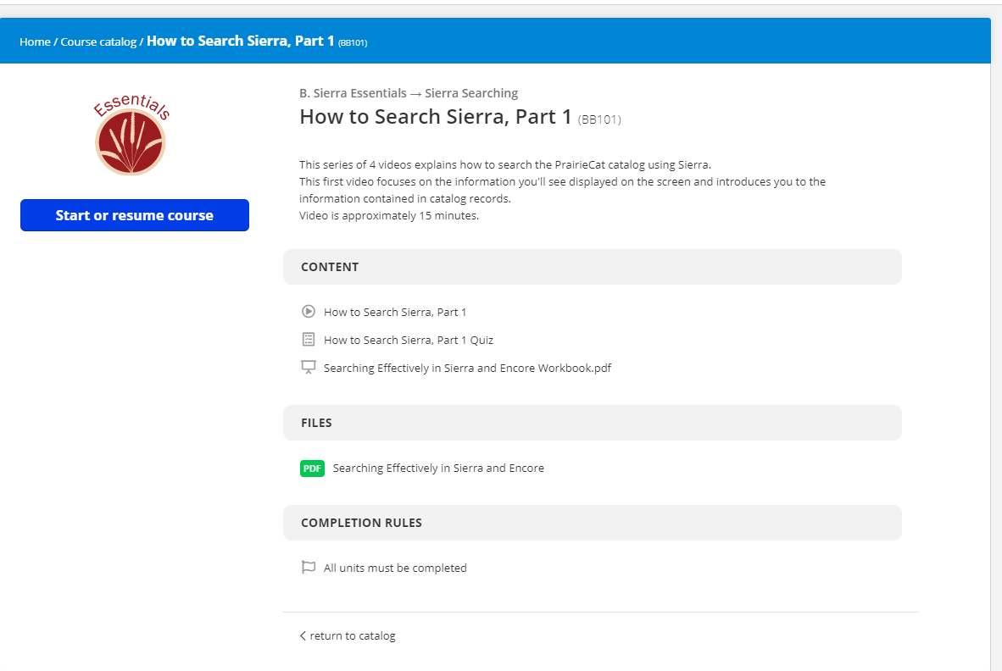
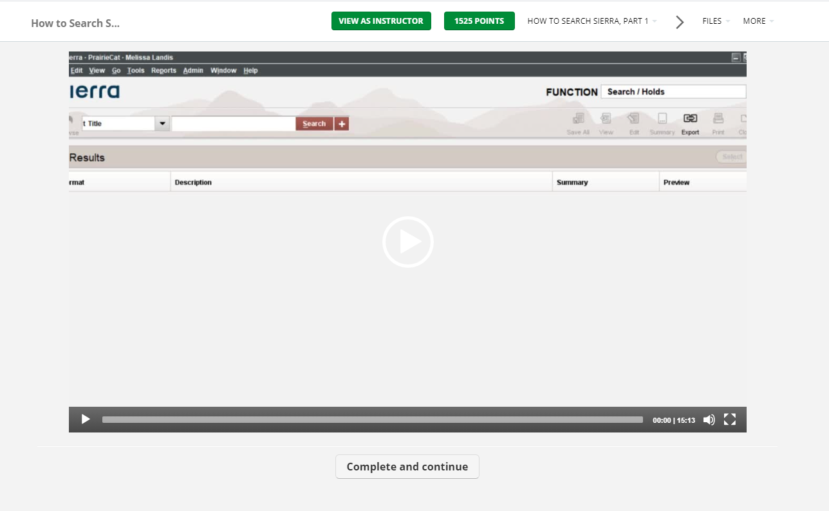
Talent LMS | Start or Resume Course
Select Start or resume course
Complete each section and continue
Use menu bar to navigate through course

Slide 41
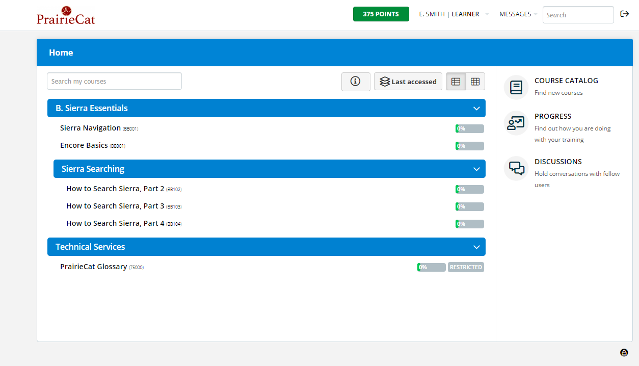
Talent LMS | My Courses
Home screen displays courses you are enrolled in
Select Progress to view the courses you have completed

Slide 42
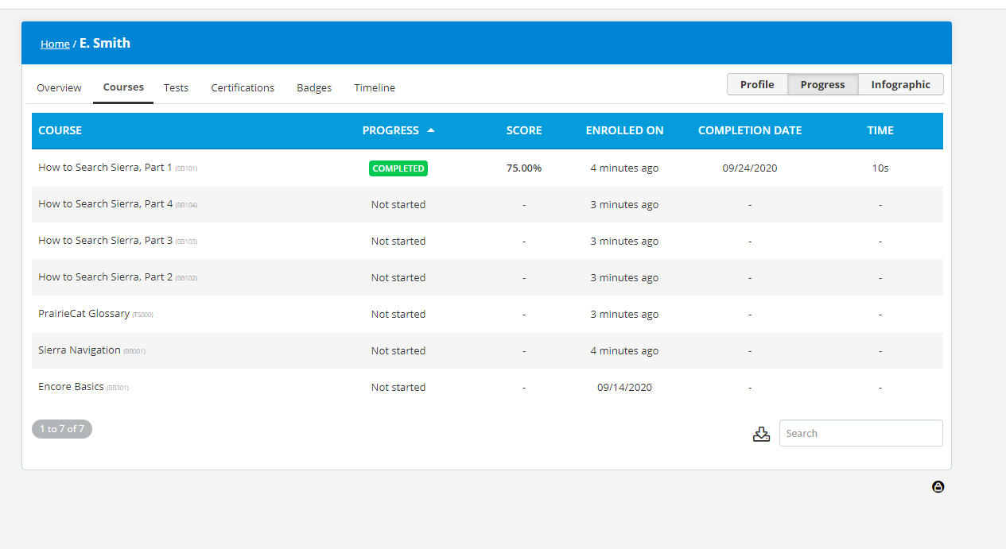
Talent LMS | My Courses
Select Progress to view the courses you have completed

Slide 43
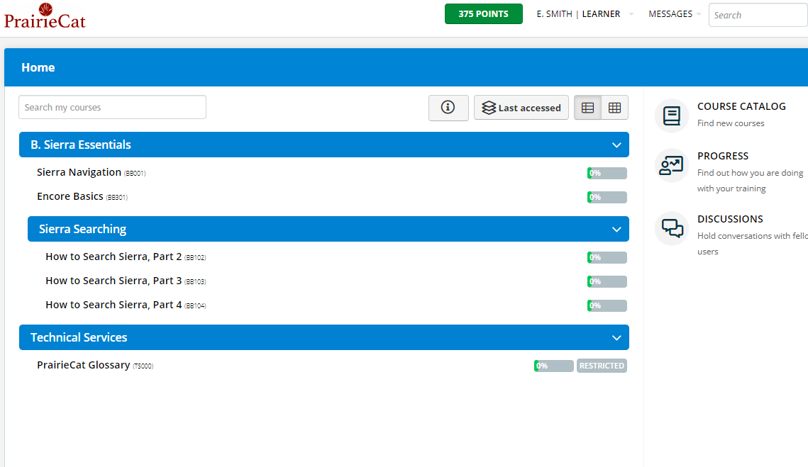
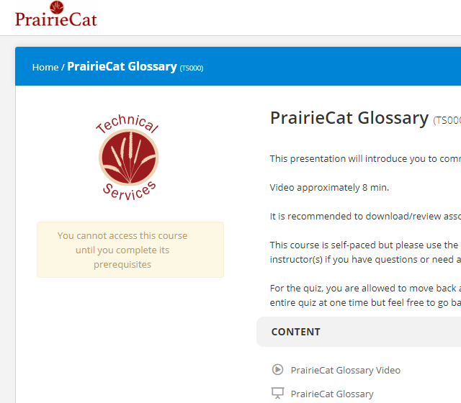
Talent LMS | Prerequisites
Some course have Prerequisites
Complete the Prerequisites to access the other courses

Slide 44
Talent LMS | Message Instructor
While in the Course you are taking
Under the More drop down menu
Select Send message to instructor

Slide 45
Questions?

Slide 46
THANKS
Contact Info
Carolyn Coulter, Director
Carolyn.coulter@prairiecat.org
Elizabeth Smith, Training and Outreach Coordinator elizabeth.smith@prairiecat.org

Slide 47
THANKS!
Do you have any questions?
youremail@freepik.com
+91 620 421 838
yourcompany.com
Please keep this slide for attribution.

